Slide 1
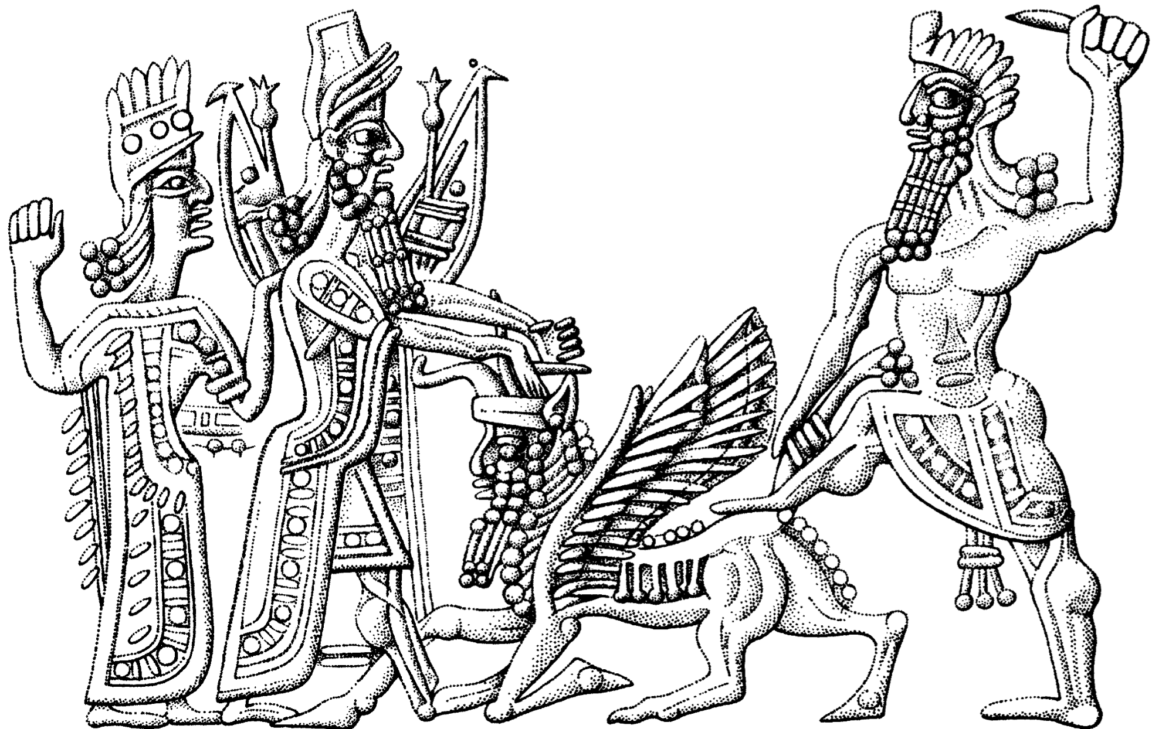
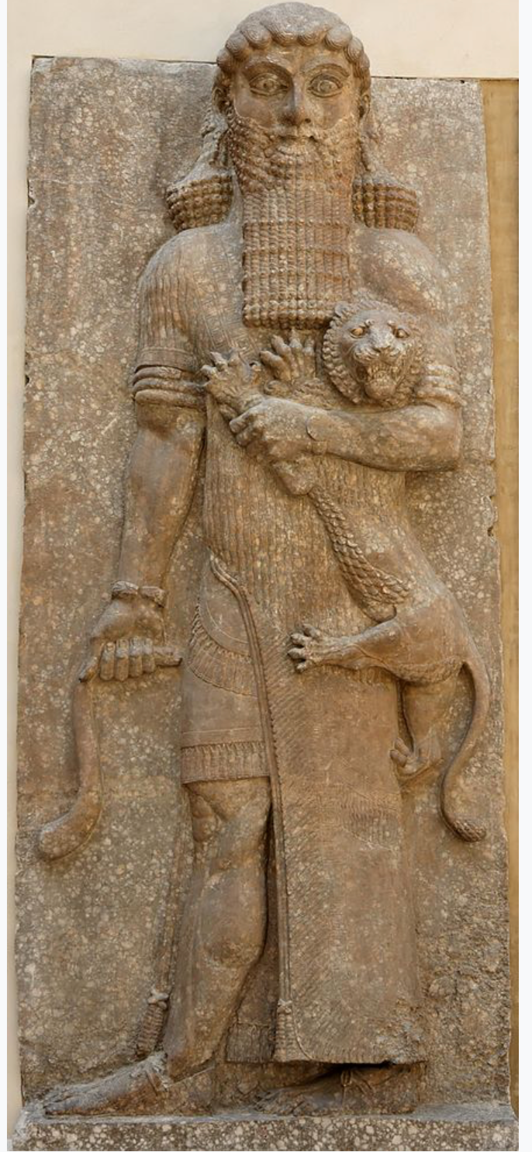
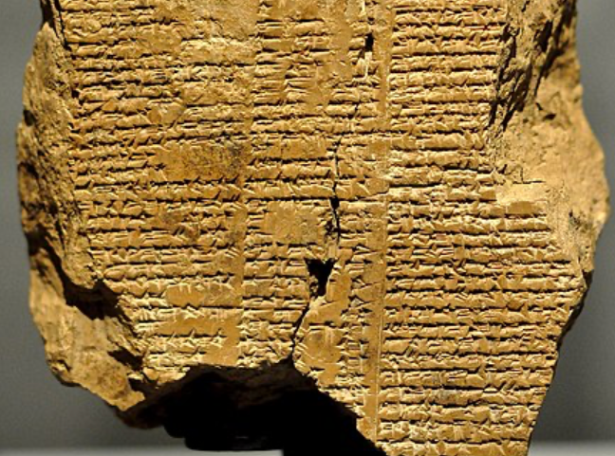
Reading “The Man Who Saw the Deep”: Gilgamesh
(1999): The Man Who Saw the Deep, selections <https://delong.typepad.com/files/gilgamesh-selections.pdf>
Gilgamesh was a historical king of the Sumerian city-state of Uruk.
He probably ruled sometime between 2800 and 2500 BC and was posthumously deified.
He became a major figure in Sumerian legends during the Third Dynasty of Ur (c. 2112 – c. 2004 BC).
The Epic of Gilgamesh was written in Akkadian during the late second millennium BC.
J. Bradford DeLong brad.delong@gmail.com 2020-01-14

Slide 2
Gilgamesh Poses a Problem to the People of Uruk
To the god Anu the gods of the heavens, the lords of initiative, spoke:
“A savage wild bull you have bred in Uruk-the-Sheepfold, He has no equal when his weapons are brandished. “His companions are kept on their feet by his contests, [The young men of Uruk] he harries without warrant. Gilgamesh lets no son go free to his father, By day and by [night his tyranny grows] harsher. “Yet he is the shepherd of Uruk-the-Sheepfold, Gilgamesh, [the guide of the] teeming [people.] Though he is their shepherd and their [protector,] Powerful, pre-eminent, expert [and mighty,] Gilgamesh lets no girl go free to her bride[groom.]”
The warrior's daughter, the young man's bride: To their complaint the god [Anu] paid heed…
J. Bradford DeLong brad.delong@gmail.com 2020-01-14

Slide 3
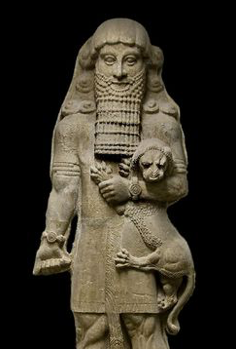
Inequality Has Ruled since Shortly After the Invention of Agriculture III
“He has taken all their children, for is Gilgamesh not the shepherd of his people?
“Gilgamesh does not leave a daughter to her mother, nor the maiden to the warrior, nor the wife to her husband.
“Yet Gilgamesh is the magnificent and glorious shepherd of his people.
“The gods heard the people’s cry, and the gods of heaven beseeched the Lord of Uruk, Anu the god…”

Slide 4
The Gods Respond, and We Have the First Road-Buddy Picture…
The gods:
“They summoned Aruru, the great one: 'You, Aruru, created [mankind:] now fashion what Anu has thought of! 'Let him be a match for the storm of his heart, let them vie with each other, so Uruk may be rested!' The goddess Aruru heard these words, what Anu had thought of she fashioned within her. The goddess Aruru, she washed her hands, Took a pinch of clay, threw it down in the wild. In the wild she created Enkidu, the hero, Offspring of silence, knit strong by Ninurta…”
J. Bradford DeLong brad.delong@gmail.com 2020-01-14

Slide 5
Inequality Has Ruled since Shortly After the Invention of Agriculture
Once you have farms, you have large social groups
Bigger than, say, 100 at most
And you can’t run away…
Thugs with spears—and thugs with time to train…
Grifters with knowledge of the stars (which is, I must admit), useful…
And we were off and running…

Slide 6
Inequality Has Ruled since Shortly After the Invention of Agriculture II
“Around the enclosed space that is Uruk he walks, Mighty like the wild bull, head raised high. None with weapon might challenge him as rival. His men stand at attention, longing for his orders;
But the old men of Uruk grouse that Gilgamesh has left no son to his father, For his arrogance has grown boundless…”

Slide 7
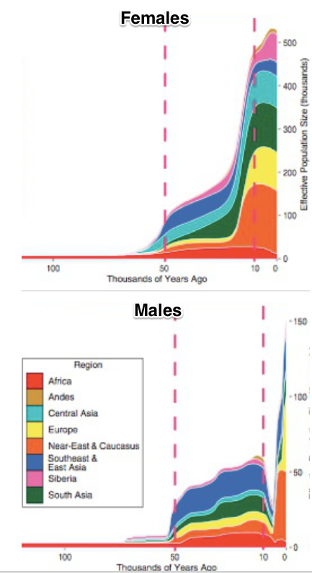
Inequality and Patriarchy
Everyone inherits their mitochondria from their mothers
Every male inherits his Y-chromosome from his father
From 5000-2000 BC, a huge chunk of Y-chromosome lineages are not propagating
Polygyny for some—and non-matrimony for others
Persistence of (male) descent groups
What’s life like for women as this goes on?
https://logarithmichistory.wordpress.com/2015/09/27/the-patriarchal-age/
http://genome.cshlp.org/content/early/2015/03/13/gr.186684.114.full.pdf

Slide 8
The Gini Coefficient
The “Gini Coefficient”
If the bottom 3/4 got 1/4 of the income and the top 1/4 the rest (evenly distributed), the Gini would be 0.5
If the bottom 2/3 got 1/3 of the income and the top 1/3 the rest (evenly distributed), the Gini would be 0.33
This is income: not status. the 4M slaves in the U.S. in 1860 would have objected most strongly to claim that U.S. then no more unequal than Britain
If you were to think like a utilitarian—and assume that each doubling of income is equally valuable in a utilitarian sense—a move from a Gini of 0.5 to 0.33 would be like a 30% boost to everyone’s income

Slide 9
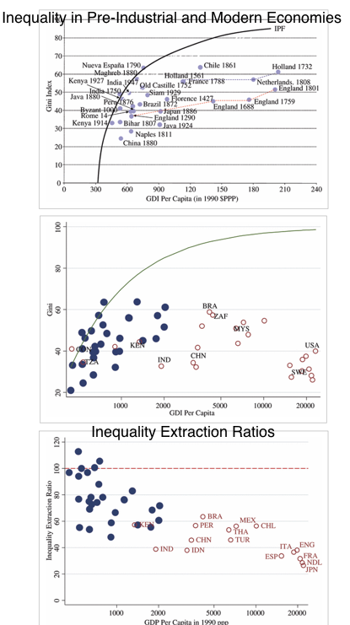
Agrarian Age Economies Look to Have Been About 80% as Unequal as They Could Have Possibly Been
In a poor agrarian-age economy, inequality cannot be too great.
If it is, then poor women are too skinny to ovulate and poor children so malnourished as to have compromised immune systems.
In which case they die, and so “decrease the surplus population”.
http://onlinelibrary.wiley.com/doi/10.1111/j.1468-0297.2010.02403.x/full

Slide 10
Questions
What do we learn from Gilgamesh?
What is the solution to tyranny—in this epic, at least?
J. Bradford DeLong brad.delong@gmail.com 2020-01-14

Slide 11
Further Reading
J. Bradford DeLong brad.delong@gmail.com 2020-01-08

Slide 12
Catch Our Breath…
Ask a couple of questions?
Make a couple of comments?
Any more readings to recommend?

